Slide 1
LungGuard: An interactive tool to determine lung cancer risk
By: Alex Biuckians
Mentor: Maryam Shahbaz Ali
June 10, 2026

Slide 2

Introduction
Current M.S. Data Science Student at GWU. Expected Graduation: May 2027
B.A. in Sport Management, minor in Data Analytics at High Point University. Graduation: December 2024
Focused on Machine Learning, Data Visualization, and Predictive Modeling
Built LungGuard as a personal project to go beyond coursework and build something impactful
Notes:
Take out graduation

Slide 3
Introduction: Mentor
Maryam Shahbaz Ali: AI Engineer | Healthcare AI Researcher | Founder
Award-winning AI practitioner, recent MSBA graduate from The George Washington University, and Research Trainee at Children's National Hospital
Specializes in LLMs, RAG systems, Explainable AI (EBM, SHAP), responsible machine learning, predictive analytics, and decision-support systems

Slide 4
Executive Solution
Problem
Lung Cancer kills ~125,000 Americans annually – but it’s survivable when caught early
Standard ML models give clinicians a single number: “73% probability”, is useless without context
Solution
LungGuard: estimates an individual’s lung cancer risk based on 27 variables
Individual risk score
SHAP explanation
Intervention engine
The threshold is set at .48 (not the default .5)
Expected
Critical: Above MCC threshold of .62. Immediate LDCT referral
Moderate: between decion threshould MCC thresholds of .48 and .62, respectively. 3-6 follow-up
Low: Below F2 threshold of .48. Routine annual screening.
Notes:
Critical: model is highly confident
Model signals to act but not enough for immediate referral.

Slide 5
Dataset
Kaggle Dataset: “Lung Cancer Prediction Dataset” https://www.kaggle.com/datasets/dhrubangtalukdar/lung-cancer-prediction-dataset
1,000 patients across four risk dimensions
Demographics
Smoking behavior
Environmental exposure
Clinical
Target Variable: elevated lung cancer risk
Variable Breakdown
46.9% lifestyle
35.7% clinical markers
17.4% demographics
Synthetic Data with clinically-informed structure
Variable relationships ground in medical literature

Slide 6
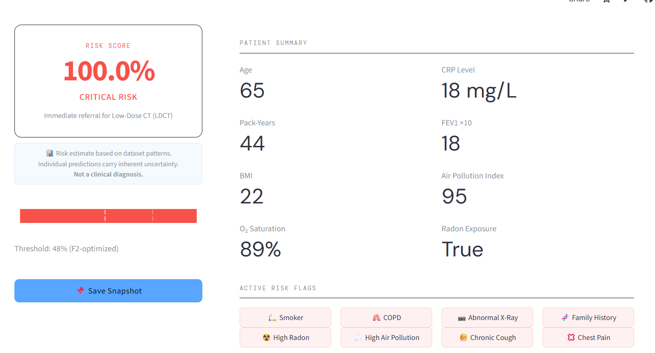
Live Demo
https://lungguard.streamlit.app/

Slide 7
What’s Next
Real Data
Built and validated on synthetic dataset to demonstrate methodology.
Next Step: Acquiring real patient data to validate whether model’s performance holds on actual clinical population
Will contain collection bias, comorbidity patterns, and access disparities differ significantly from synthetic data
IRB
Project has not been approved by Institutional Review Board.
Next Step: reviewed by the Institutional Review Board to ensure patient privacy, informed consent, and ethical use of health data.
Prerequisite before it could be tested in hospital or clinical setting
Clinician Validation
No usability testing or clinical review has been conducted
Next Step: co-designing the tool with actual clinicians to validate the risk stratification thresholds, SHAP explanations, and What-If interventions align with real clinical workflows and decision-making.
Ensure the tool supports rather than replaces clinical judgement

Slide 8


Links
Github: https://github.com/alexbiuckians/LungGuard
LinkedIn
https://www.linkedin.com/in/alex-biuckians/

